Slide 1
Welcome to my Presentation

Slide 2
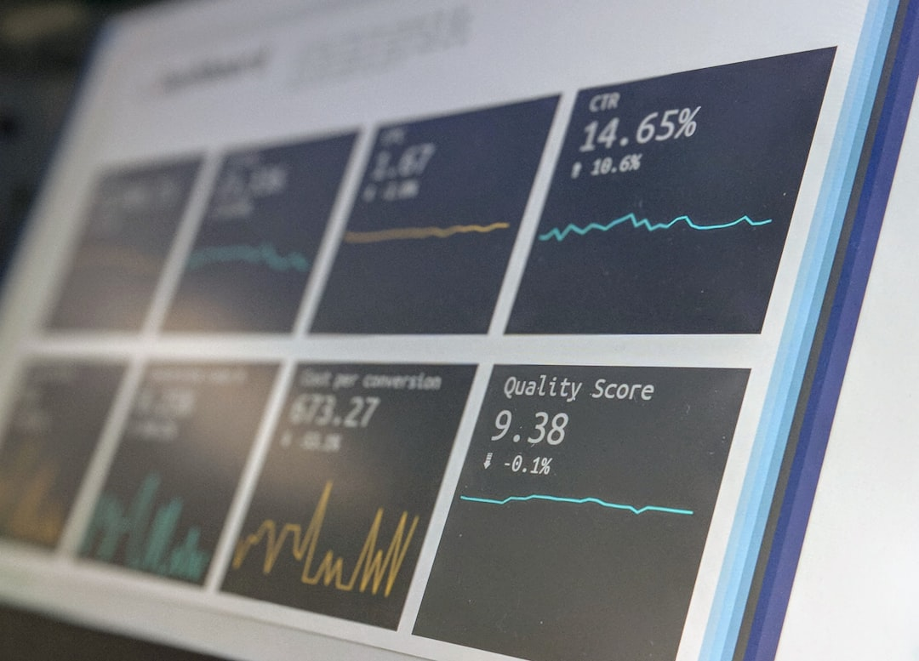
General Data Protection Regulation
Md Rabiul hasan
Batch 47
Roll 03

Slide 3
Introduction
UNDERSTANDING GDPR
The General Data Protection Regulation (GDPR) is crucial legislation that enhances individuals' control over their personal data. It aims to unify data protection standards across the EU, enforce compliance, and safeguard privacy rights.

Slide 4

Key Features
USER RIGHTS
CORE PRINCIPLES
Individuals have rights over their data, including the right to access, erase, and rectify personal data held by organizations.
GDPR emphasizes transparency, data minimization, and accountability. These principles guide organizations in how they handle personal data.

Slide 5
Regulatory Challenges
CHALLENGE | DESCRIPTION
Implementation Costs | Financial burden of compliance
Awareness and Training | Need for employee education
Data Management Capabilities | Technology and processes required for compliance

Slide 6
Research Questions
WHAT ARE THE IMPACTS?
HOW IS COMPLIANCE ACHIEVED?
WHAT ARE THE CONSEQUENCES OF NON-COMPLIANCE?
Investigating how GDPR impacts businesses and consumer trust is critical for understanding compliance effectiveness.
What measures are organizations taking to achieve GDPR compliance, and how effective are these measures?
Exploring legal and financial repercussions for non-compliance provides insight into the regulation's enforcement.

Slide 7
Applications and Functionality
IN MARKETING
Companies must secure customer permission before processing personal data for marketing purposes.
IN HEALTHCARE
IN EDUCATION
GDPR safeguards sensitive health data, ensuring patient consent and confidentiality.
Educational institutions must protect student data and comply with GDPR provisions.

Slide 8
Conclusion
KEY TAKEAWAYS
GDPR significantly enhances data protection for individuals. Its rigorous requirements promote accountability and transparency, leading to a more secure digital environment for personal data.

Slide 9
Thank you Everyone

